Slide 1
skill training Programs: Build Union Strength and the labor movement
Stuart Bass Keystone Development Partnership

Slide 2
“If the labor movement is not an instrument of social change, it is nothing.”
---Walter Reuther, UAW
Notes:
What does this mean for unions?
Walter Reuther (1907-1970) was president of the United Automobile Workers (UAW) from 1946 until his death in 1970. Under his leadership, the UAW grew to more than 1.5 million members, becoming one of the largest unions in the United States. Reuther was widely admired as the model of a reform-minded, liberal, responsible trade unionist—the leading labor intellectual of his age, a champion of industrial democracy and civil rights who used the collective bargaining process and labor's political influence to advance the cause of social justice for all Americans.

Slide 3
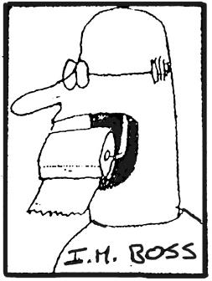
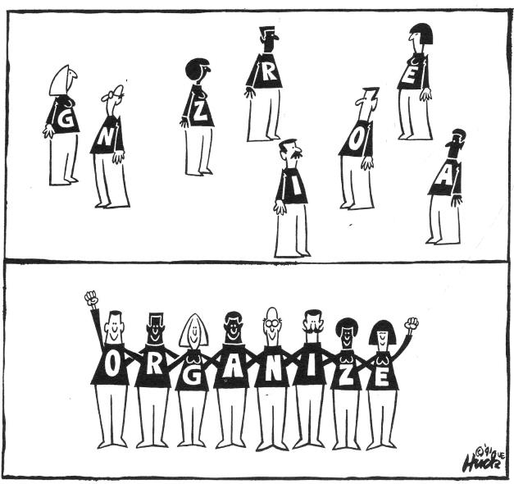
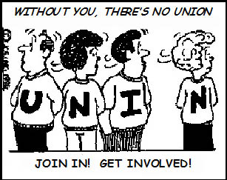
Internal Organizing
Through
Workforce Development

Slide 4
Union as messenger or contract enforcer - caught between employer & members
U
N
I
O
N
Employer
Work rule changes
Job description changes
Reorganizations
Contract Negotiations
MEMBERS’
WRATH

Slide 5
Members can’t scream at bosses so they take it out on the union
U
N
I
O
N
Employer
Work rule changes
Job description changes
Reorganizations
Contract Negotiations
MEMBERS’
WRATH

Slide 6
Union as Organizer
Employer
Work rule changes
Job description changes
Reorganizations
Contract Negotiations
Members see the Union as their organization with a Proactive Response

Slide 7
Labor Management Training Programs address
Union as Organizer
Members see Union as their organization
Members as trainers
Members outreach to community
Industry Challenges
Employer
Partner in joint training programs
Recruitment through union programs

Slide 8
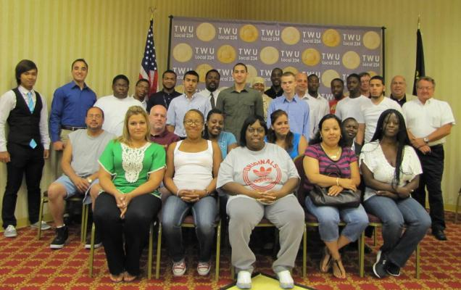
You can make a difference

Slide 9
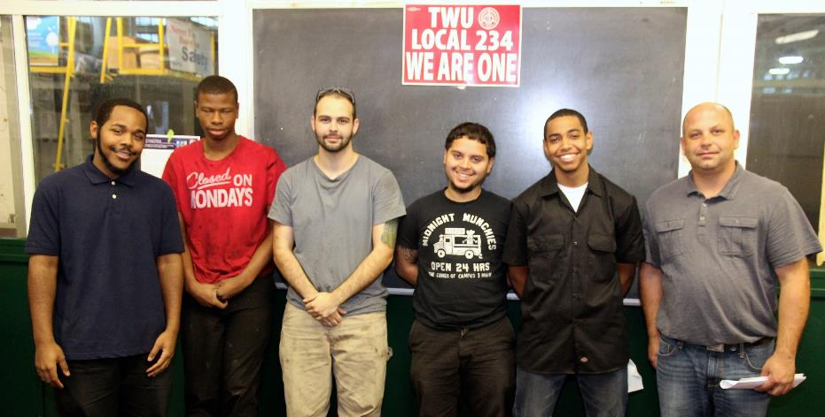
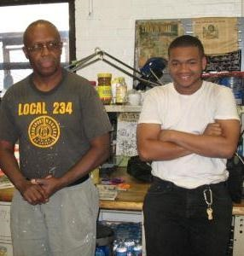
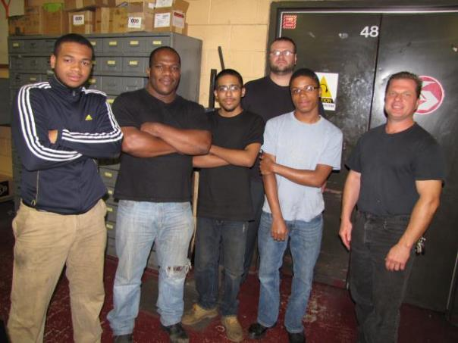
Youth programs
Build Unionism in the community

Slide 10
Unions and employers with a Workforce Strategy
created and sustained through strong partnerships
- a proven strategy for a pipeline of qualified workers for employers and industries
Notes:
Attract and retain workers with the right skills for employers
Public workforce agencies identify workforce solutions and collaborative approaches that benefit job seekers and employers
There are 400,000 registered apprenticeships nationwide in more than 1,000 occupations.
Apprenticeship works for more than 150,000 employers and labor management organizations.

Slide 11
Measuring Coalition Success
Social Change |  | Organizational Strength
Policy victory | Shifting the political climate | Coalition sustained relationships | Increasing capacity of participating organizations
Notes:
Measuring Coalition Success
Build to win, win to build; more than one way to define success
Policy victory = winning the public policy goals outlined in the campaign
Shifting political climate = changing the power relationships of ideas & the environment positively to make future success more likely
Coalition sustained relationships = the relationships between coalition partners continues and grows deeper
Increasing capacity of participating organizations = coalition partners see their own organizational capacity grow with the success of the coalition.

Slide 12
Shared Vision

Slide 13
What You Do Counts
Did you identify potential partners?
Did you analyze the capacity of your union and other partners?
What is one issue you could work on in for your Board? (Or deepen current coalition work?)
Did you identify potential barriers and think of possible solutions?

