Slide 1
Funding & Sustaining Workforce Intermediary Organizations April 23, 2019
Washington State Labor Council

Slide 2
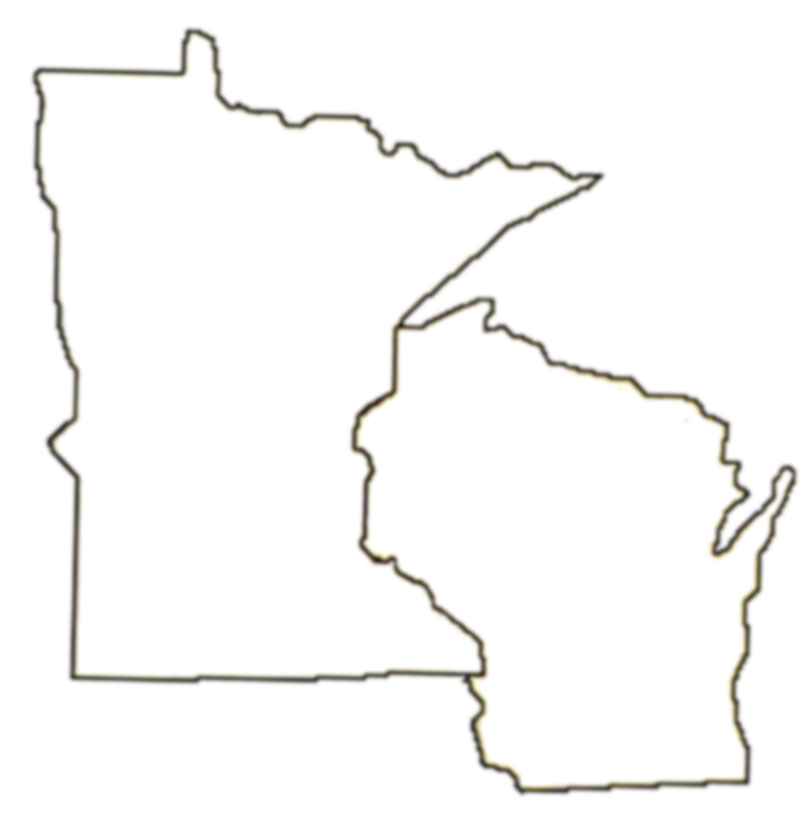
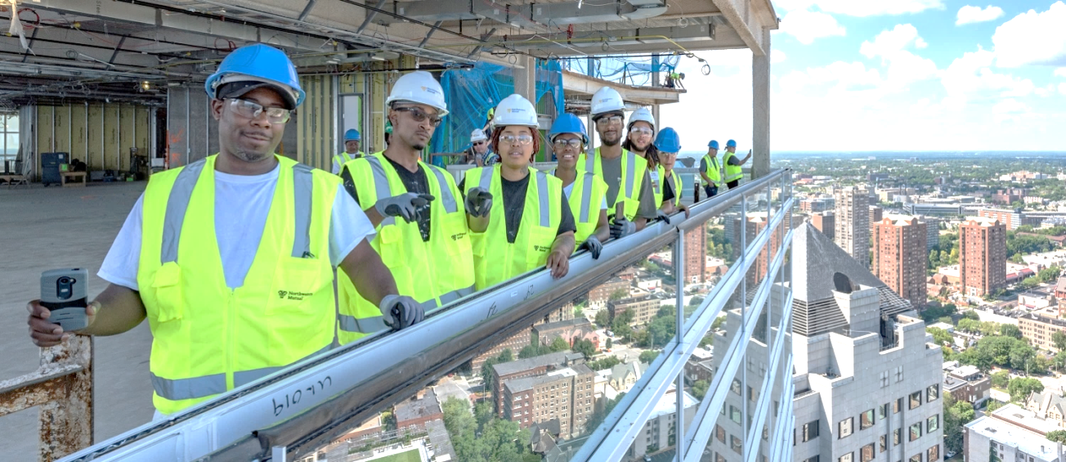
Locations
Twin Cities
Milwaukee
Racine
Madison
INDUSTRY LED
WORKER CENTERED
COMMUNITY FOCUSED

Slide 3
WRTP / BIG STEP
501(c)3 – Non-profit Corporation WI
Board Composition
10 Labor
10 Business
Operating Locations
Milwaukee
SC WI & SE WI
Minnesota Regional Training Partnership
Annual Operating Revenue
2017 $3.8 million
60 grant sources and contracts
Largest sources Construction Industry Contribution & State / Federal DOL funds

Slide 4
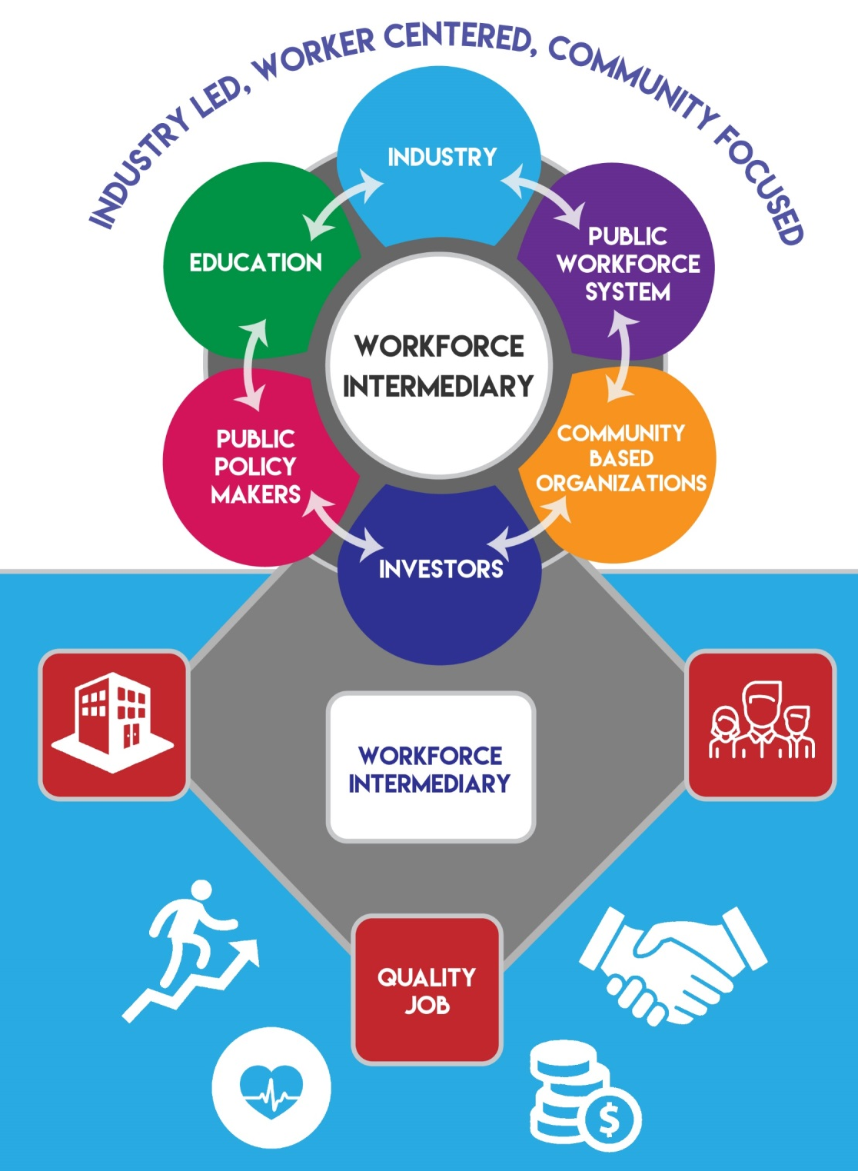
WORKFORCE INTERMEDIARY
2018 SNAPSHOT
Industries
3
High Road Employers
298
Labor Partners
26
Partnerships
385
Participants
3346
Notes:
Workforce Intermediary Business Model

Slide 5
Intermediary Functions
Convene Industry Leadership
Labor, Business, Industry Associations, & JAC/JATC’s
Needs Assessment & Industry Employment Data
Working with employers and labor to understand real needs and demand- NOT LMI data
Develop and Align Public & Private Funding
Foundations, Local/State/National Grants, Industry Funds

Slide 6
Intermediary Functions
Coordinate broad partnership with community, public, and private organizations
Coalition Building to address local employment issues and public policy impacting workers
Program Functions
Design and implement demand driven workforce development solutions
Data & Impact Performance
Communication and success stories that demonstrate value and impact public investments and policy

Slide 7
FUNDING & SUSTAINABILITY
Developing and utilization of resources is a full cycle process that is on-going and ever present. Who are your investors ? What do they want?
Fund Development
Operating Funds
Reporting & Auditing
Rinse & Repeat

Slide 8
FUND DEVELOPMENT
MISSION
LEADERSHIP
PITCH
SCALE & WORKLOAD
IDENTIFICATION OF FUNDING
FUNDING STRATEGY

Slide 9
OPERATIONALIZATION
Public, Private, & Industry
Funding Diversity = Stabilization
Methodology
Cost Allocation. Fee for Service, Unit Cost
Alignment & Braided Funding
Staff – Program & Field
Program Services
Training Related & Support Services
Administration

Slide 10
REPORTING & AUDITING
Fiscal Framework
HR, Insurance, Accounting, & Data
Audit & Monitoring
Management
Accountability & Transparemcy
Conitnuouos Funding
Politics
Grant & Fund Reporting
$$ & ##

Slide 11
THANK YOU!
Mark Kessenich, WRTP/BIG STEP
mkessenich@wrtp.org
414-801-9242

